Slide 1

Marketing Data and Technology
Draw Insights from Marketing Data

Slide 2

Part One:
Setting Goals

Slide 3
Identify Key Business Objectives
Key Business Objective: A defined goal or outcome used to plan the desired direction of your company. Write at least 3 but no more than 5 business objectives that support your business model. Each objective should be SMART.
1 | Increase new users to website by 30% within the next three months.
2 | Increase sales by 20% over the next 6 months.
3 | Increase social media followers by 40% over the next six months.

Slide 4
Identify Key Performance Indicators
Key Performance Indicator (KPI): A quantifiable metric used to determine how effectively your key business objectives are being met. Ensure that the specific metric is clearly identified.
1 | Number of new users visiting website per month
2 | Number of sales over the next 6 months
3 | Number of followers on all social media accounts

Slide 5
Part Two:
A/B Testing Proposal

Slide 6
A/B Testing Proposal: KPI, Variable, and Hypothesis
KPI used as basis for the A/B test
Number of new users to our website per month
Variable that will have an impact on the KPI
New users to website coming from Tiktok
Hypothesis for your A/B Test
If we increase our tiktok campaign by 4 tiktok videos per week showing our product, we will get a 30% increase of new users to our website.

Slide 7
A/B Testing Proposal: Details and results
Details of the A/B test
Variations being tested: | We aren’t utilizing Tiktok
 | We start using Tiktok like we use Instagram reels
User groups: | Previous website users vs new website users
Data collection tool: | Data Analytics
Length of the test: | 4 weeks
Describe how you would determine the results of the A/B test
The metric that I am looking at is the number of new website users on Google analytics. I am looking for a higher number of new users.

Slide 8
Part Three:
Data Exploration

Slide 9
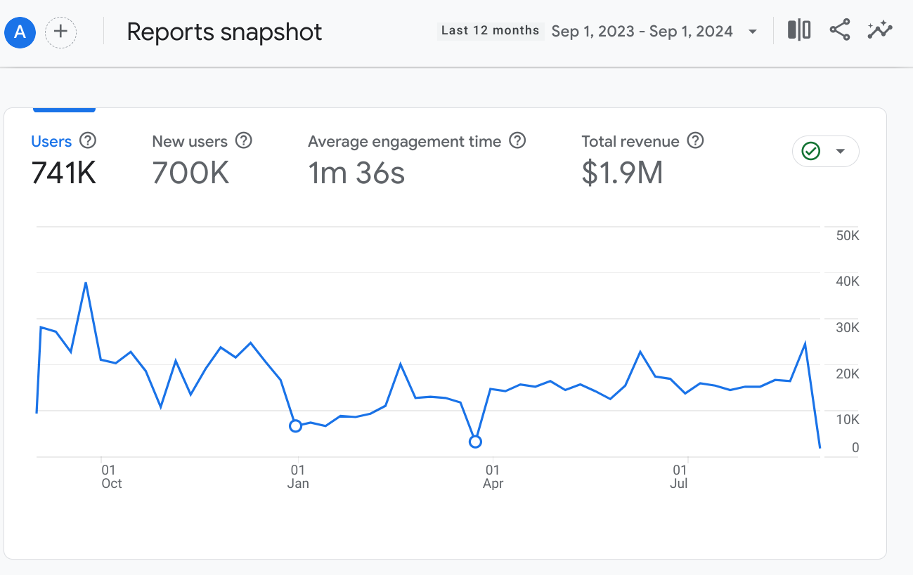
Reports Snapshot
From the Reports Snapshot, select a twelve month time period you would like to explore.
Ensure that the following are visible in the screenshot:
Timeframe
New users
Axis values

Slide 10
Reports Snapshot
Which month had the most new users?
September 2023
Which month had the fewest new users?
March 2024
Write some ideas why certain trends are associated with these specific months?
September is the end of summer and people are starting to think about school starting and the upcoming fall and winter holidays. March is still a time when people are recovering from winter holiday spending and also planning for summer vacation so extra money for purchases may be low.

Slide 11
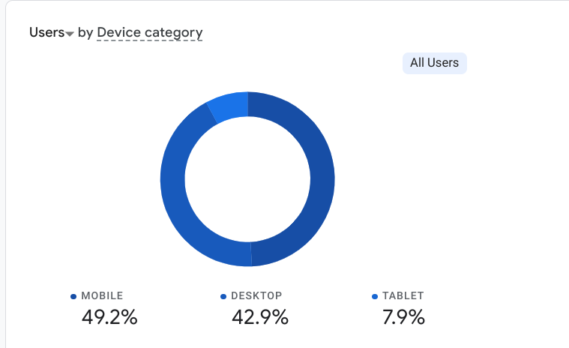
User Tech
Please go into the User → Tech → Tech overview report for the following:
For the twelve month period you’ve chosen, provide a screenshot showing percentage chart (donut charts) of All Users that came from mobile, desktop, and tablet devices.
Ensure that the following are visible in the screenshot:
Device Category
Donut chart showing % breakdown by device
Note that the time frame selected does not need to be visible in the screenshot..

Slide 12
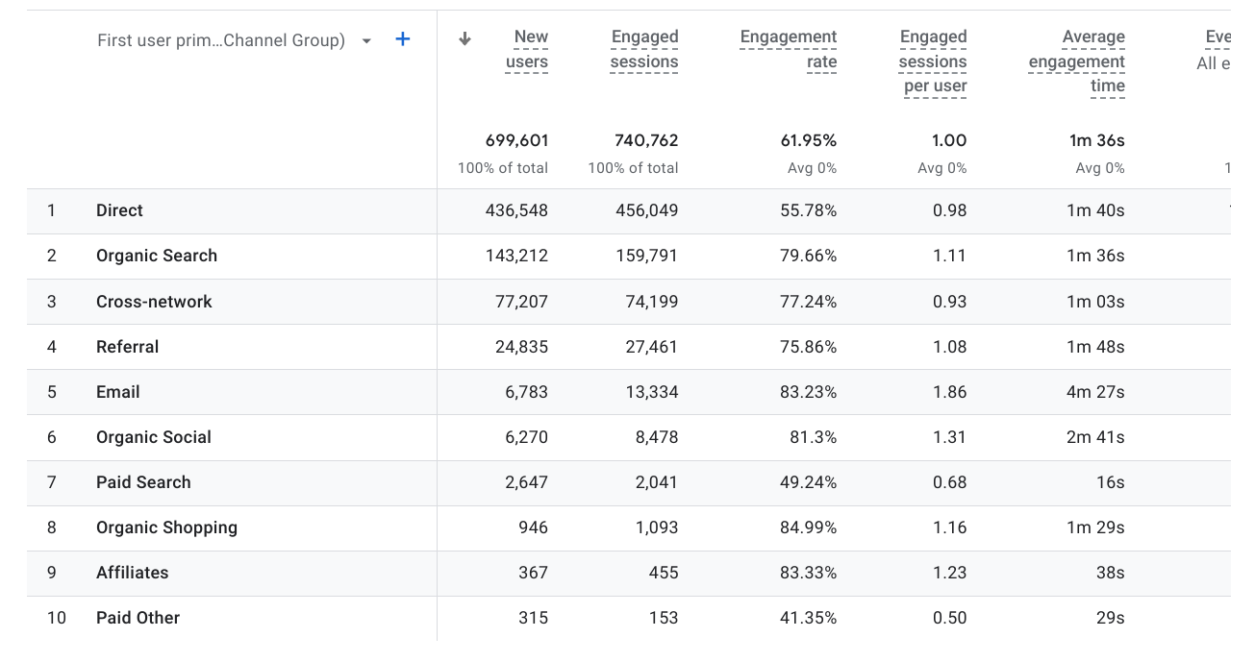
User Acquisition
For this section, if you are using your own business’s Google Analytics data but do not have eCommerce capabilities established, please use the Google Analytics demo data provided from the Google Merchandise store.
Take a screenshot that shows the Engagement rate of the different acquisition channels over a 12 month period.
Ensure that the following are visible in the screenshot:
Channel group
Users
Engagement Rate
Note that the time frame selected does not need to be visible in the screenshot, but will be reflected by the number of users.

Slide 13
User Acquisition
Which channel groups had the highest and lowest engagement rates?
The highest was Organic shopping, and the lowest was paid other.
Which channel groups had the highest and lowest total revenue?
Highest revenue was Direct, and the lowest with $0.00 for both was affiliates and paid other.
What do these metrics mean, based on your experience?
It means that we aren’t bringing any money in with our affiliates or paid groups, and our largest amount of revenue is from direct sales.

Slide 14
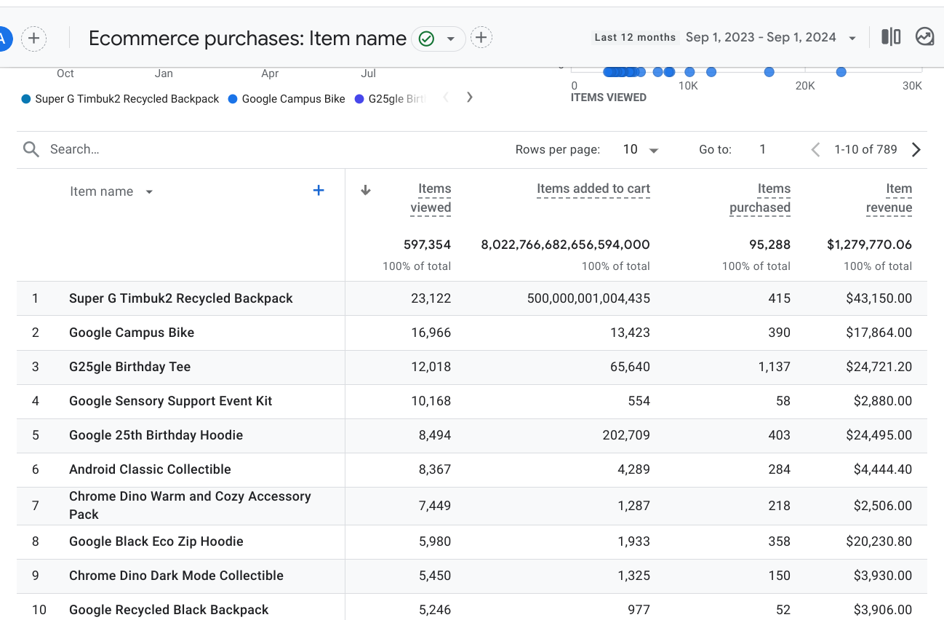
Monetization
For this section, if you are using your own business’s Google Analytics data but do not have eCommerce capabilities established, please use the Google Analytics demo data provided from the Google Merchandise store.
During the twelve month period you’ve selected, provide a screenshot that shows the Item name that contributed the highest number of unique purchases and the item name that was responsible for the largest percentage of revenue? (Screenshot(s) only; no annotation required.)
Ensure that the following are visible in the screenshot:
Item names
Number of items purchased
Item revenue

Slide 15
Part Four:
Segmentation

Slide 16
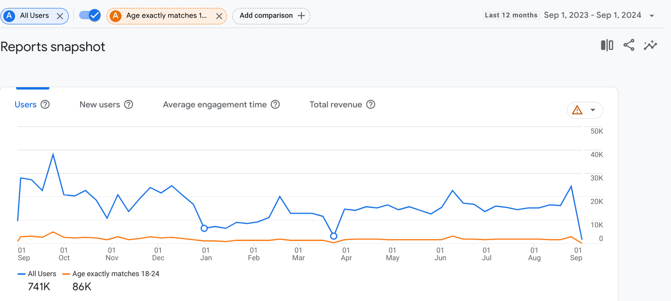
Audience Segment: Demographics
Place the screenshot here, that includes a comparison of your chosen Audience Demographic segment and “All Users”
Values used: | Age exactly matches 18-24

Slide 17
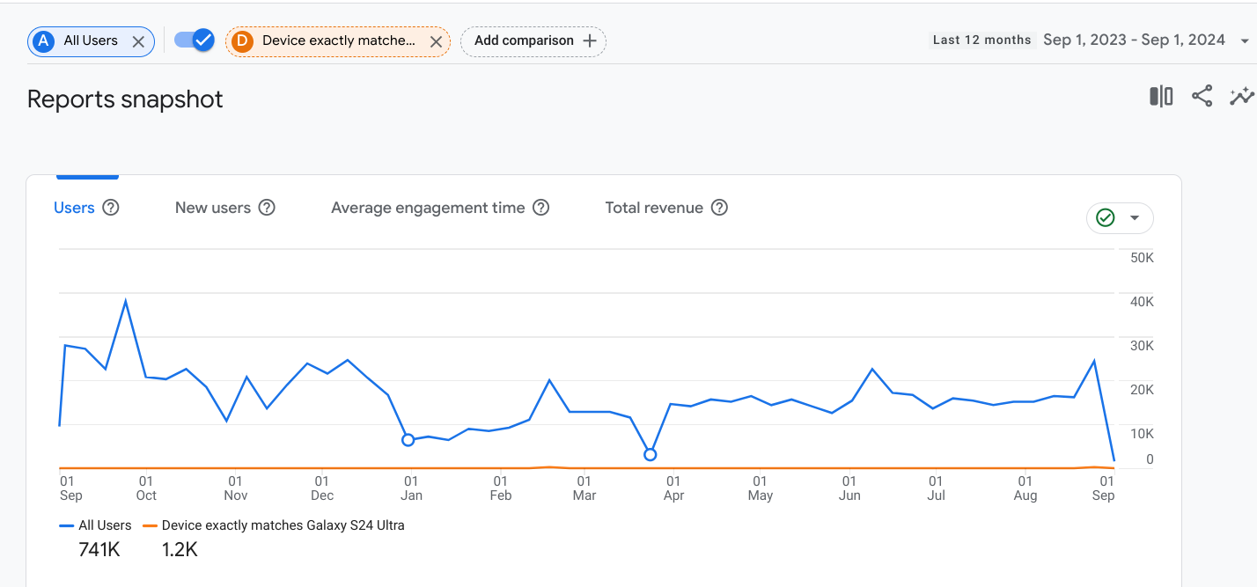
Audience Segment: Technology
Place the screenshot here, that includes a comparison of your chosen Audience Demographic segment and “All Users”
Values used: | Device exactly matches Samsung S24 ultra

Slide 18
Part Five:
Analysis and Suggestions

Slide 19
Google Merchandise Store data
You can find the results of the Google Merchandise Store campaigns below.
Campaign Name | Cost | Revenue | ROAS
Tech Trends: Discover the Latest Google Gear | $5,000 | $3,000 | 0.6
Shop with Google: Unleash Your Digital Lifestyle | $5,000 | $8,000 | 1.6
Google Gadgets Galore: Elevate Your Tech Game | $5,000 | $8,000 | 1.6
Gear Up with Google: Your One-Stop Tech Shop | $8,000 | $13,000 | 1.625
Google Merch Madness: Score Big on Tech Essentials | $5,000 | $2,000 | 0.4
Unlock the Power of Google: Shop the Best in Tech | $2,000 | $3,500 | 1.75
Totals | $30,000 | $37,500

Slide 20
Business Sales Growth
Based on the data provided, how might the campaigns be realigned and improved to potentially achieve a 20% YOY sales growth without additional cost? You can assume that the data will remain consistent over the projected time frame. Please reference specific data to support your answer, such as metrics and campaigns.
You could get the answer by asking yourself: Which campaign would I spend less, and which would I spend more?
I would spend less on the “Google March Madness” campaign because it brings less revenue compared to other campaigns. I would spend more on “Unlock the Power of Google: Shop the Best in Tech” because it would bring in the highest amount of revenue for the company. The ROA on “Shop the Best in Tech” is 1.75 which is the highest return. If we increase the spending on that campaign to $6000, we will increase revenue with that campaign alone to $10,500. Then if we stop investing in “Google March Madness”, that will decrease our spending by $5000. Just the increase in “Shop the Best in Tech” would be an increase of well over 20%.

Slide 21
eCommerce improvements
Looking at your website pages or the Google Merchandise Store website and current eCommerce experience, identify one change to the eCommerce UX and one additional eCommerce option you would recommend implementing.
Example: One way to improve eCommerce capabilities would be to add the option of a digital wallet with the option to securely store and manage cards that have been used for payment, along with the option of using PayPal or Apple Pay.
UX change:
I would add an option to check out as a guest. Some users don’t necessarily want to log in to make a purchase, they want to get in and purchase as quickly and smoothly as possible.
Other eCommerce change or addition:
I would change the word “sale” from red to blue or purple. Red can come off as harsh, where blue is more calming.

Slide 22
Technology
It is time for some exploration! You need to find 2 emerging marketing technologies that you could use in a technology stack. For each one, you need to describe why you would use that tool.
1 | Metaverse Marketing
 | The metaverse lets potential customers try on products virtually. This would allow them to see what it looks like on before they buy, instead of just seeing how it looks on a model like in traditional advertising.
2 | Hyper-personalized marketing
 | Usually, email marketing involves sending the same email to every customer. Personalized marketing could mean sending emails to the customer at the best time for them based on previous email activity. This would mean that they’re more likely to see it come through.

